Slide 1
Credit Card Approval Prediction - Kaggle
Nagui BEN LEMRID

Slide 2
Problem statement
Credit score cards are a common risk control method in the financial industry. It uses personal information and data submitted by credit card applicants to predict the probability of future defaults and credit card borrowings.
The bank is able to decide whether to issue a credit card to the applicant. Credit scores can objectively quantify the magnitude of risk.
In this context, the goal is to build a machine learning model to predict if an applicant is 'good' or 'bad' client, different from other tasks, the definition of 'good' or 'bad' is not given.
You should use some technique, such as vintage analysis to construct you label. Also, unbalance data problem is a big problem in this task.

Slide 3
Resolution steps
Data import
Exploratory analysis
Data cleaning and preparation
Data modelling and prediction
Conclusion

Slide 4
1. Data Import
This first step mostly consists in importing the 2 datasets with application and credit data into dataframes.
We also identify at this stage some of the basic python libraries that are going to be useful to the problem resolution (pandas, numpy, matplotlib, seaborn, sklearn…).

Slide 5
2. Exploratory analysis
This second step might occur in some cases after the data cleaning and preparation.
But in this case, as the data were already pretty interpretable, I decided to go over the datasets to make a simple exploratory analysis pretty early
The main goals of a such step are: - identify data types and possible type changes needed - flag data discrepancies before the data cleaning (too many null values in some features, …) - get a description of the different columns’ contents - display some of the key columns' values distribution
Here, we figure out that we have some categorical features (NAME_FAMILY_STATUS, …) we will need to convert and turn the flag columns into [0,1] classes for model interpretability. Moreover, we have one specific feature with more than 30% of null values (OCCUPATION_TYPE)

Slide 6
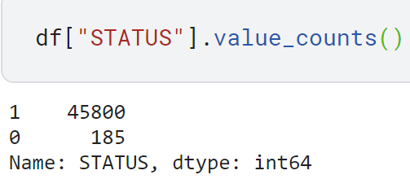
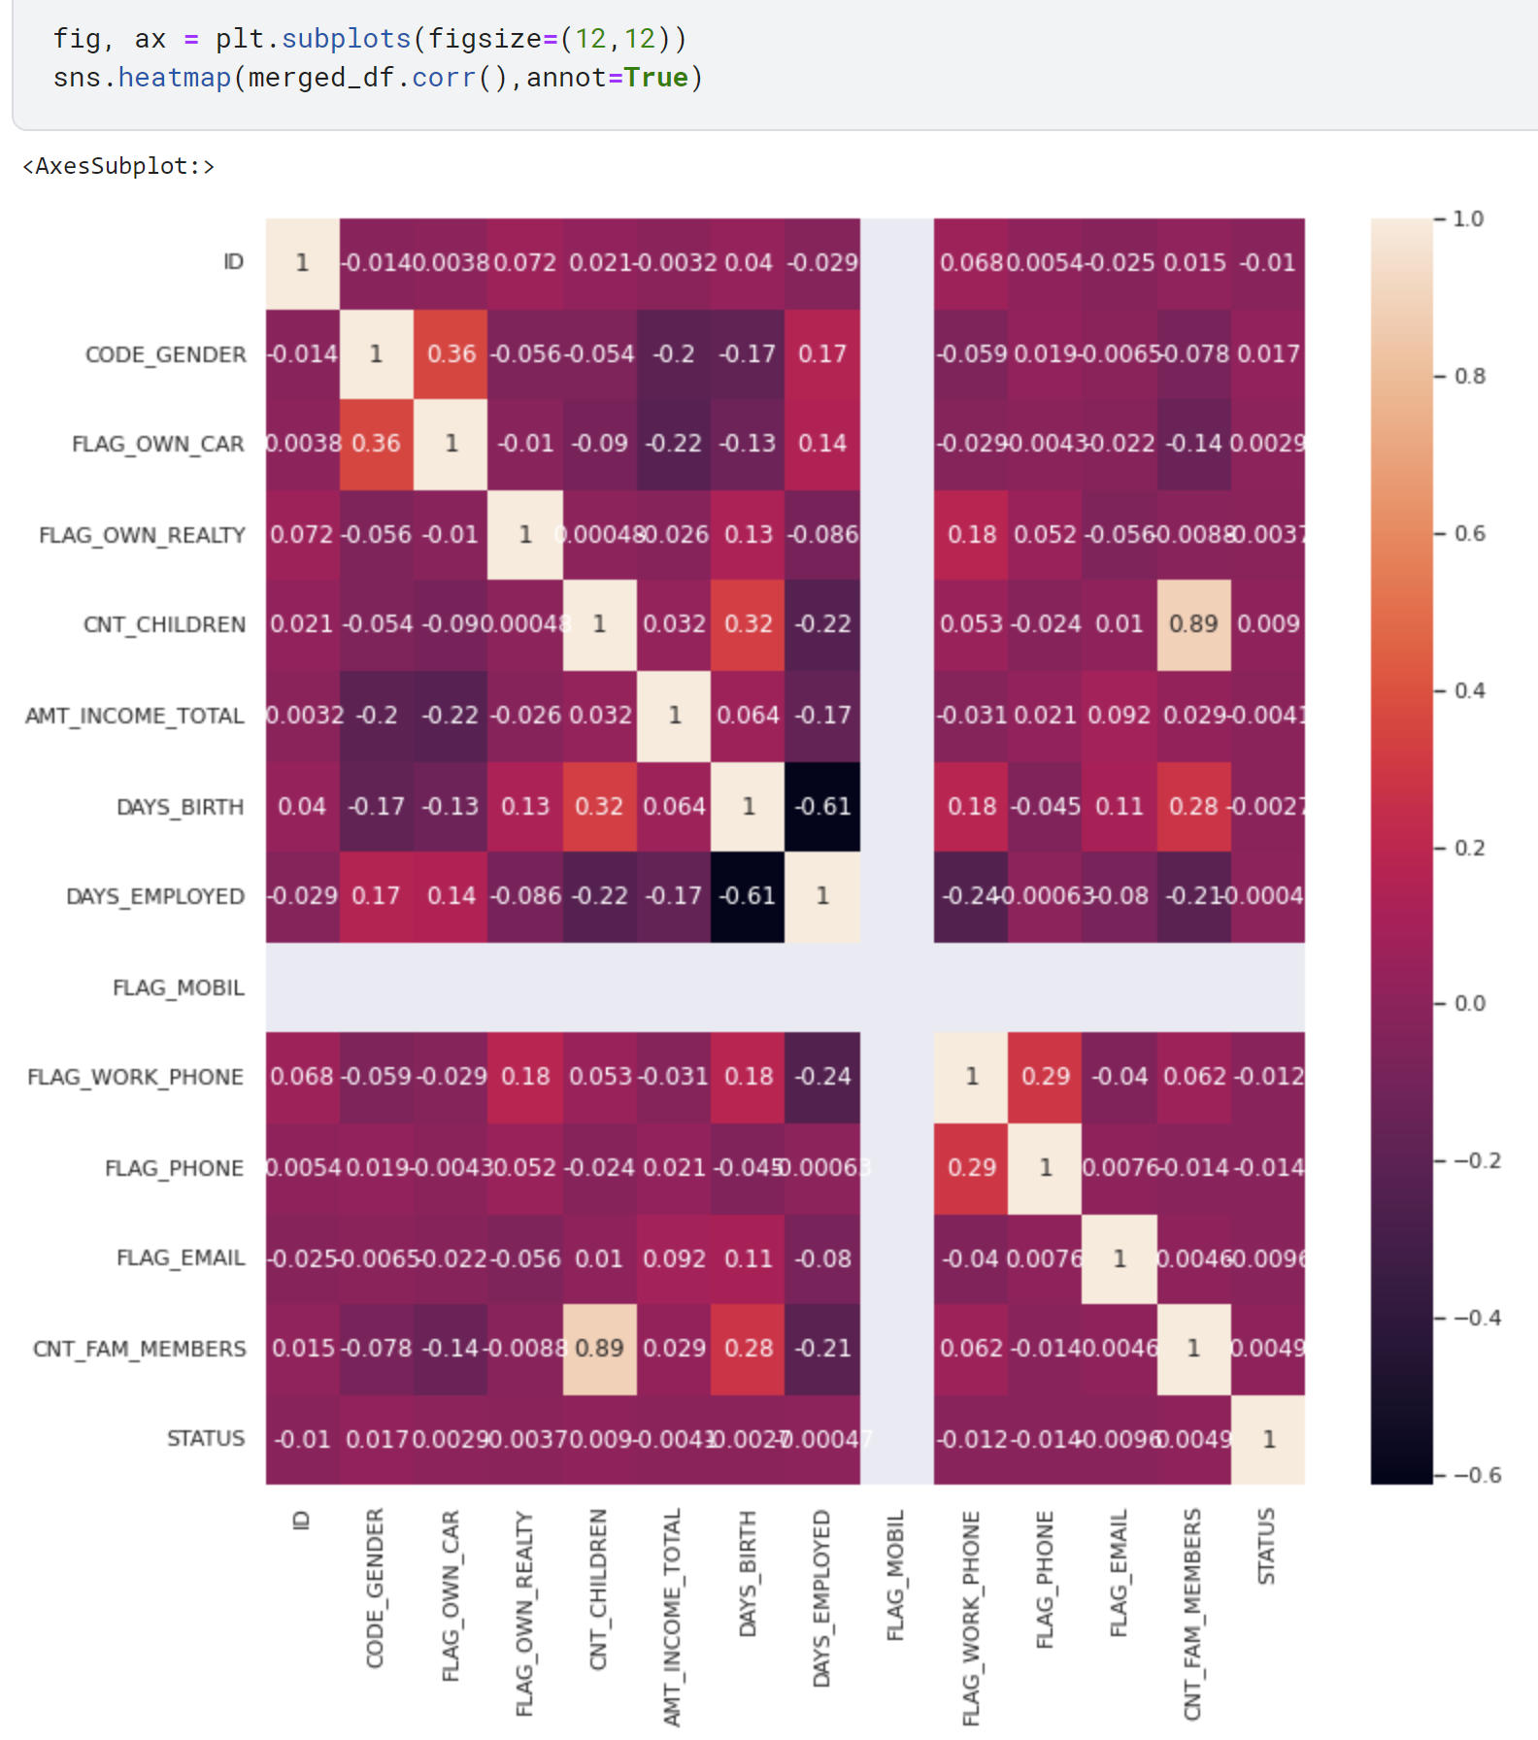
3. Data Cleaning and preparation
We drop duplicated lines from both the application dataset and the credit dataset
For the classification problem, we manually define a target variable named STATUS considering bad applicants (class 1) as the ones with at least one payment with more than 30 days overdue:
→ Data imbalance problem with too few data points from the class 0
We merge the application and the credit dataframe on the ID column.
We convert fields values [Y,N] into [0,1] and cast the categorical features into the right data types
Finally, after plotting a correlation matrix, we find out that the feature FLAG_MOBIL only contains one value so it is useless to keep it for the classification.
So we drop the column FLAG_MOBIL from the correlation matrix interpretation and the column OCCUPATION TYPE as containing too many null values
The last step is to use the get_dummies function to turn categorical features into interpretable features for a classification model

Slide 7
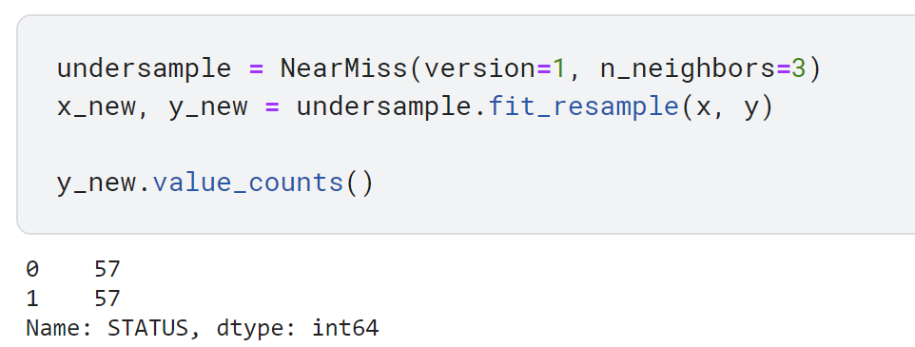
4. Data modelling and prediction (1/2)
To tackle the data imbalance problem, the solution chosen is the under sampling of the class in majority
We split our new dataframe in between a training and a test set:

Slide 8
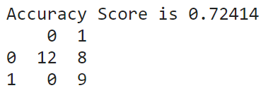
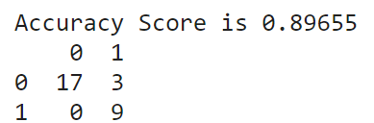
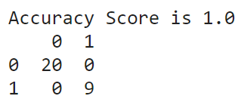
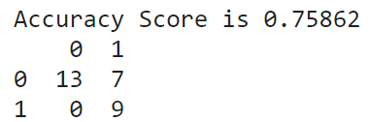
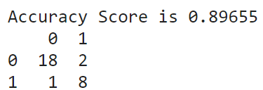
4. Data modelling and prediction (2/2)
After testing few classification algorithms and tweaking the models' parameters, we end up with the following results (we monitor the ROC score, accuracy score and the confusion matrixes):
Logistic Regression (roc=0.8): SVM classifier (roc=0.925):
Decision Tree Classifier (roc=1): Random Forest Classifier (roc=0.825):
XGBoost classifier (roc=0.897):

Slide 9
5. Conclusion
The best model to predict bad/good card customers is the Decision Tree Classifier (roc=1):
This model also makes the most sense in this business context as it is easy to interpret by displaying the decision tree leading to the prediction, which is a good point when you have to explain a data related algorithm to business/metier stakeholders.
As a next step, we could further assess that the model is not overfitted to the training dataset by setting up a cross validation process. If we notice overfitting, we would go on with the second-best model which is the XGBoost classifier (we would lose interpretability but gain model robustness)

